Slide 1

INTRODUCTION TO INFORMATION SECURITY
3(2-1)
Dr.Quratulain Alam,
Assistant Professor,
COMSATS UNIVERSITY ISLAMABAD
.

Slide 2
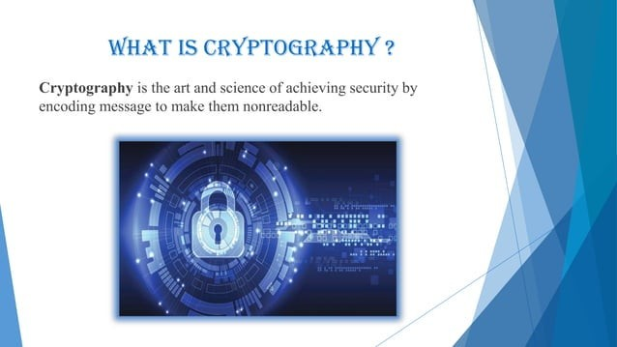

Slide 3
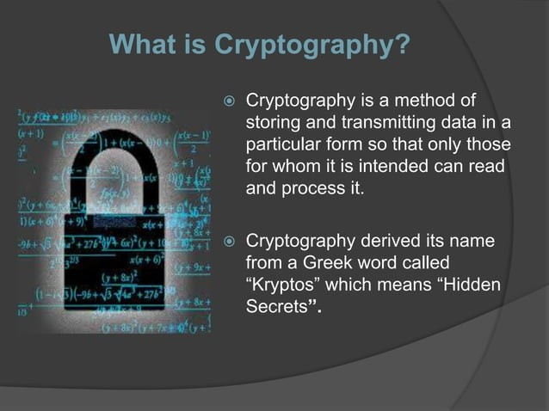

Slide 4
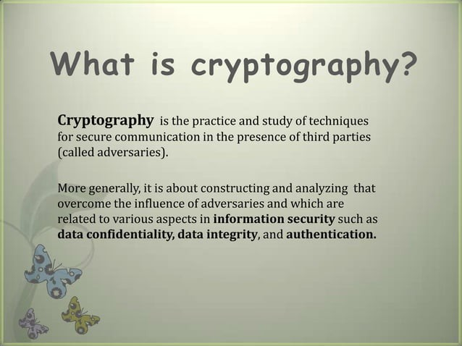

Slide 5
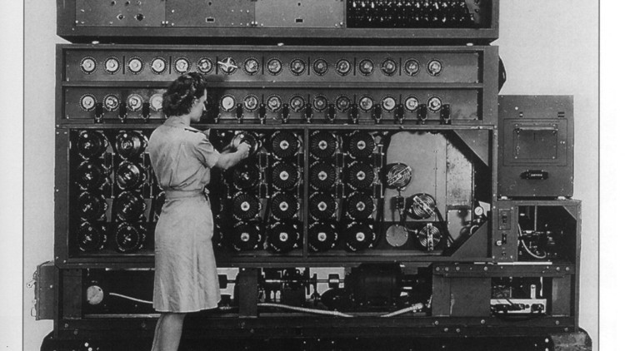
CRYPTOGRAPHY
71
▶ Scrambling of Data to hide information
▶ Used for:
▶ Confidentiality – by Encryption of Data
▶ Integrity – by Hashing & Message Digests
▶ Authentication – by Digital Signatures & Certificates

Slide 6
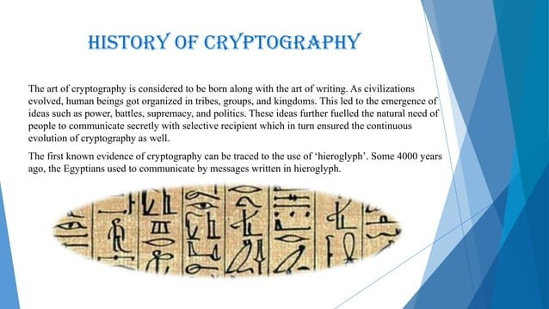
a character used in a system of pictorial writing, particularly that form used on ancient Egyptian monuments.
Notes:
a character used in a system of pictorial writing, particularly that form used on ancient Egyptian monuments.

Slide 7
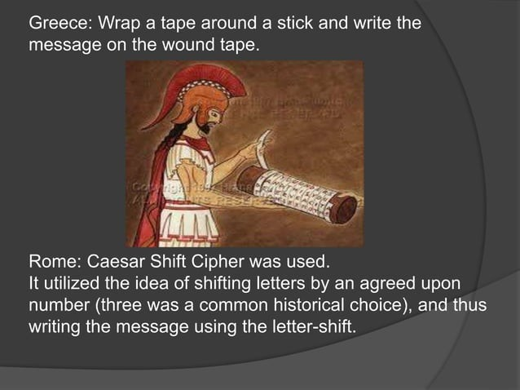

Slide 8


Slide 9
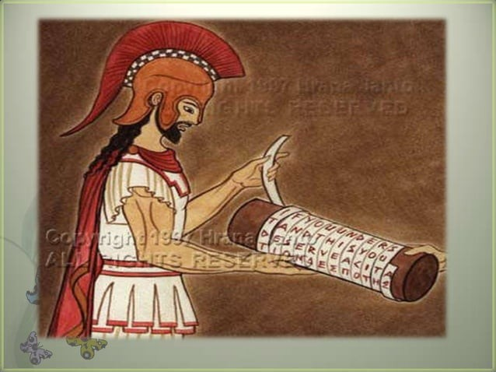

Slide 10
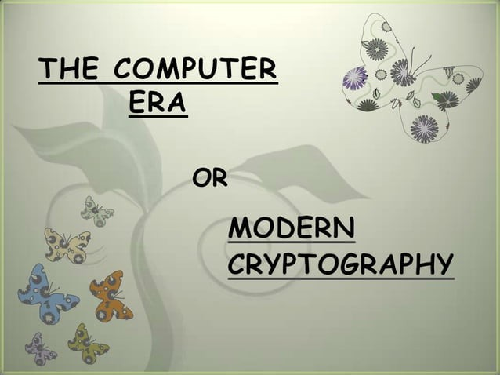

Slide 11
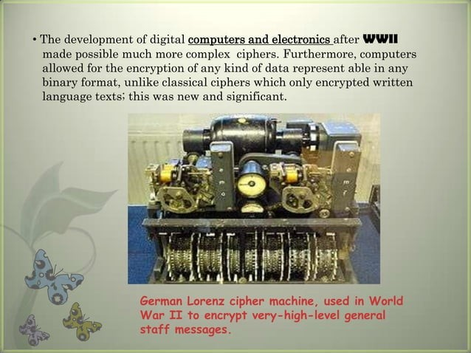

Slide 12
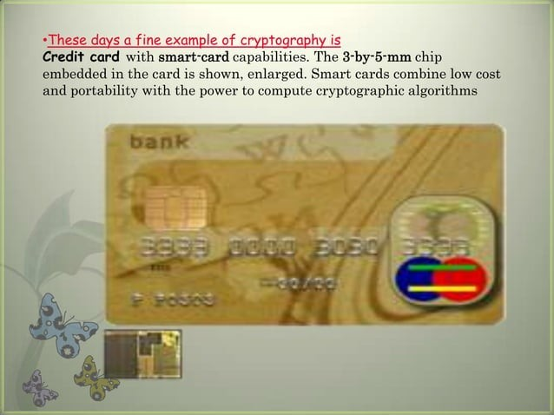

Slide 13
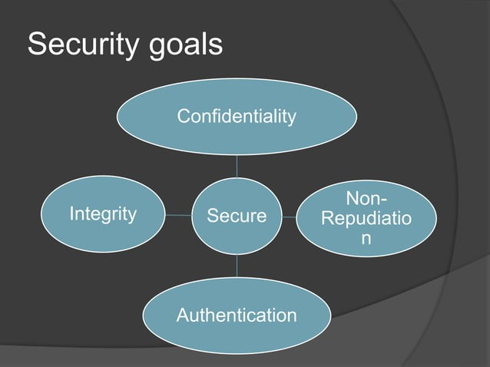

Slide 14
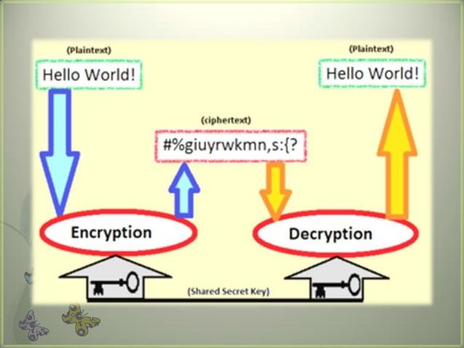

Slide 15
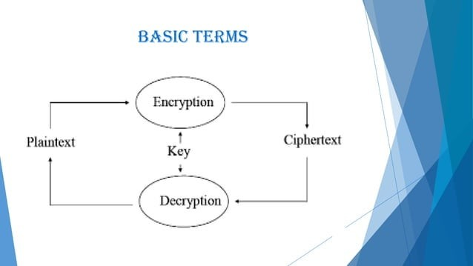

Slide 16
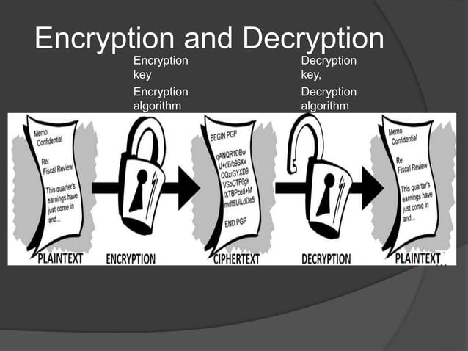

Slide 17
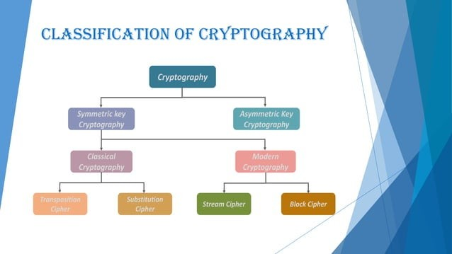

Slide 18
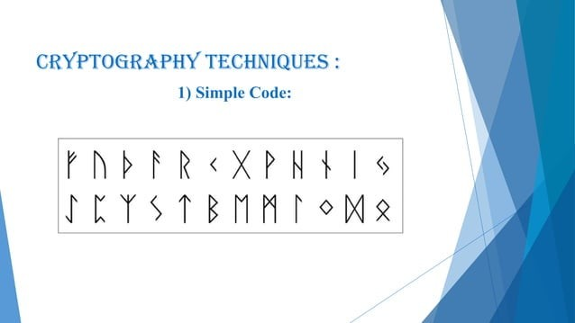

Slide 19
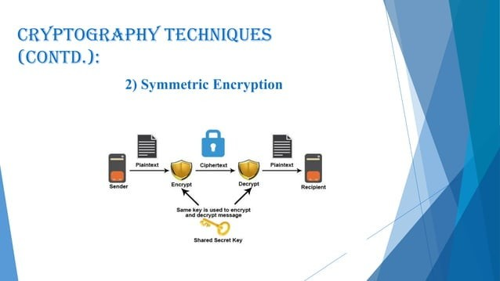

Slide 20
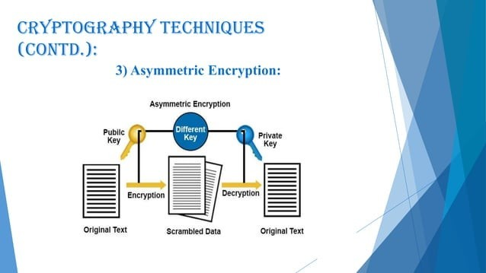

Slide 21
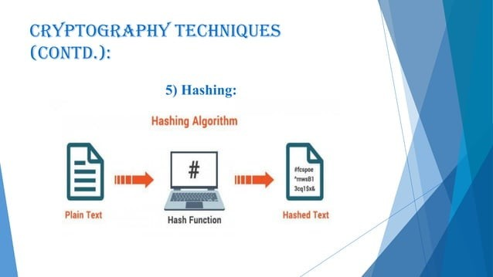

Slide 22
Hash functions are intended to be fast and efficient, generating unique hash values for each input. Hashing is irreversible, which means it's computationally impractical to recover the original data from the hash value. Hashing is often used to store passwords, create digital signatures and verify data integrity.
A hash cannot be reversed back to the original data because it is a one-way operation. Hashing is commonly used to verify the integrity of data, commonly referred to as a checksum. If two pieces of identical data are hashed using the same hash function, the resulting hash will be identical.

Slide 23
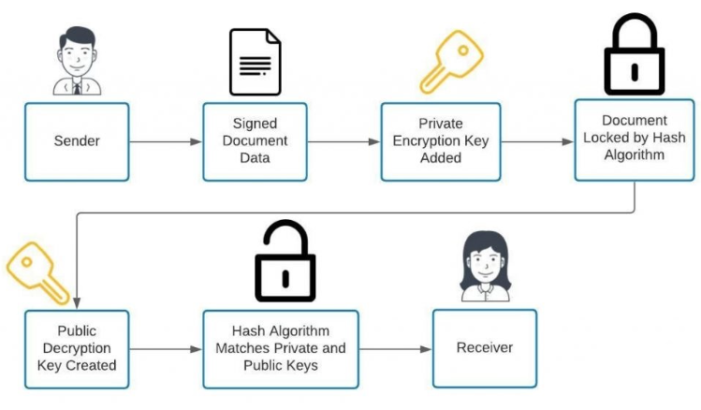

Slide 24
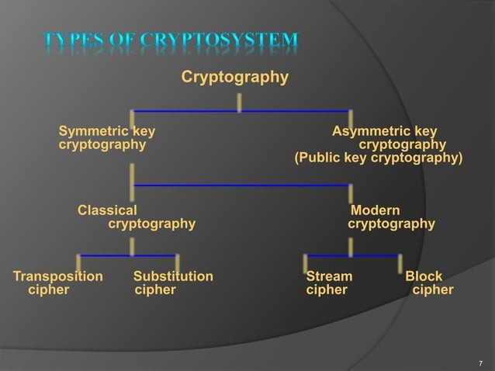

Slide 25
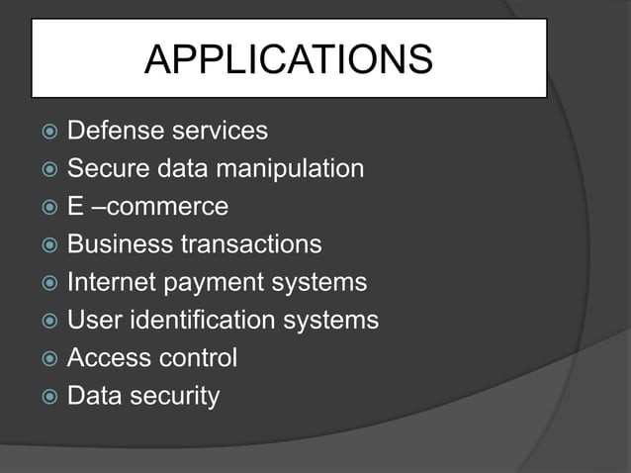

Slide 26
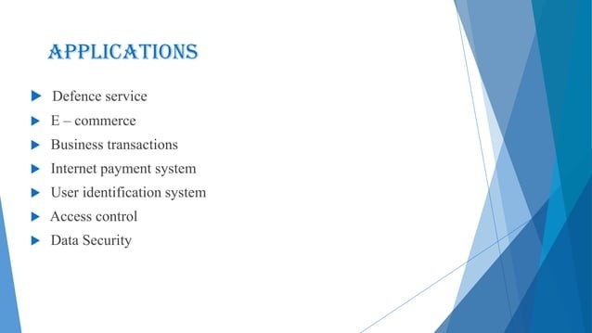

Slide 27
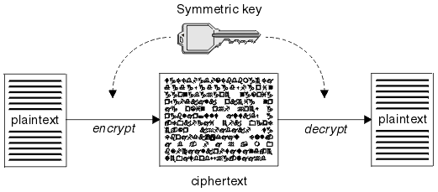
CRYPTOGRAPHY - CONCEPTS
74
▶ Plain Text & Cypher Text
▶ Encryption & Decryption

Slide 28
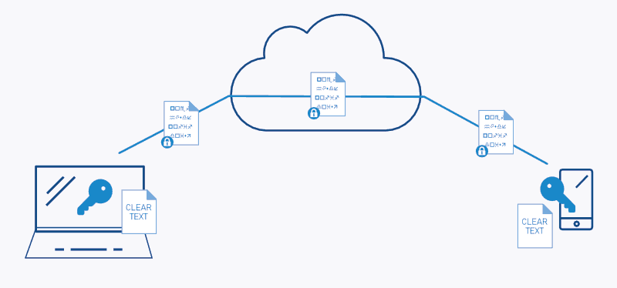
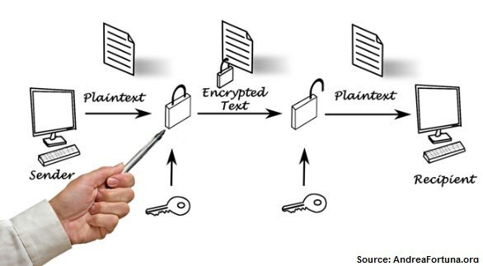
CRYPTOGRAPHY - CONCEPTS
75
▶ End to End Encryption
▶ Link Encryption

Slide 29
CRYPTOGRAPHY – ALTERNATIVES
76
▶ Steganography: A picture is worth a thousand (hidden) words
▶ Art of hiding the very existence of a message.
▶ Unlike cryptography, the contents of the message aren’t encrypted. Instead, the existence of the message is hidden in some other communications medium.
▶ For example, a message may be hidden in a graphic or sound file, in on storage media, in traffic noise over a network, or in a digital image.
▶ Digital watermarking:
▶ Technique similar (and related) to steganography that can be used to verify the authenticity of an image or data, or to protect the intellectual property rights of the creator. Watermarking is the visible cousin of steganography — no attempt is made to hide its existence. Watermarks have long been used on paper currency and office letterhead or paper stock.

Slide 30
SYMMETRIC KEY CRYPTOGRAPHY
77
▶ Symmetric key cryptography, also known as symmetric algorithm, secret key, single key, and private key cryptography, uses a single key to both encrypt and decrypt information. Two parties (for our example, Thomas and Richard) can exchange an encrypted message by using the following procedure:
▶ 1. The sender (Thomas) encrypts the plaintext message with a secret key known only to the intended recipient (Richard).
▶ 2. The sender then transmits the encrypted message to the intended recipient.
▶ 3. The recipient decrypts the message with the same secret key to obtain the plaintext message.
▶ In order for an attacker to read the message, he must guess the secret key

Slide 31
SYMMETRIC KEY CRYPTOGRAPHY
78
▶ Disadvantages
▶ Distribution: Secure distribution of secret keys is absolutely required either through out-of-band methods or by using asymmetric systems.
▶ Scalability: A different key is required for each pair of communicating parties.
▶ Limited functionality: Symmetric systems can’t provide authentication or non-repudiation
▶ Advantages
▶ Speed: Symmetric systems are much faster than asymmetric systems.
▶ Strength: Strength is gained when used with a large key (128 bit, 192 bit, 256 bit, or larger).
▶ Availability: There are many algorithms available for organizations to select and use.

Slide 32
SYMMETRIC KEY CRYPTOGRAPHY
79
▶ Data Encryption Standard (DES)
▶ Triple DES (3DES)
▶ Advanced Encryption Standard (AES)
▶ Blowfish and Twofish Algorithms

Slide 33
ASYMMETRIC KEY CRYPTOGRAPHY
80
▶ Asymmetric key cryptography (also known as asymmetric algorithm cryptography or public key cryptography) uses two separate keys: one key to encrypt and a different key to decrypt information. These keys are known as public and private key pairs. When two parties want to exchange an encrypted message by using asymmetric key cryptography, they follow these steps:
▶ 1. The sender (Thomas) encrypts the plaintext message with the intended recipient’s (Richard) public key.
▶ 2. This produces a ciphertext message that can then be transmitted to the intended recipient (Richard).
▶ 3. The recipient (Richard) then decrypts the message with his private key, known only to him.

Slide 34
ASYMMETRIC KEY CRYPTOGRAPHY
81
▶ A public key and a private key are mathematically related, but theoretically, no one can compute or derive the private key from the public key.
▶ This property of asymmetric systems is based on the concept of a one-way function.
▶ A one-way function is a problem that you can easily compute in one direction but not in the reverse direction.
▶ In asymmetric key systems, a trapdoor (private key) resolves the reverse operation of the one- way function.
Hash functions are intended to be fast and efficient, generating unique hash values for each input. Hashing is irreversible, which means it's computationally impractical to recover the original data from the hash value. Hashing is often used to store passwords, create digital signatures and verify data integrity.
A hash cannot be reversed back to the original data because it is a one-way operation. Hashing is commonly used to verify the integrity of data, commonly referred to as a checksum. If two pieces of identical data are hashed using the same hash function, the resulting hash will be identical.

Slide 35
ASYMMETRIC KEY CRYPTOGRAPHY
82
▶ Disadvantages
▶ Lower speed. Because of the types of algorithms that are used to achieve the one-way hash functions, very large keys are required. (A 128-bit symmetric key has the equivalent strength of a 2,304-bit asymmetric key.)
▶ Those large keys, in turn, require more computational power, causing a significant loss of speed (up to 10,000 times slower than a comparable symmetric key system).
▶ Advantages
▶ Extended functionality: Asymmetric key systems can provide both confidentiality and authentication; symmetric systems can provide only confidentiality.
▶ Scalability: Because symmetric key systems require secret key exchanges between all of the communicating parties, their scalability is limited. Asymmetric key systems, which do not require secret key exchanges, resolve key management issues associated with symmetric key systems, and are therefore more scalable.

Slide 36
ASYMMETRIC KEY CRYPTOGRAPHY
83
▶ RSA
▶ DIFFIE-HELLMAN KEY EXCHANGE
▶ EL GAMAL
▶ MERKLE-HELLMAN (TRAPDOOR) KNAPSACK
▶ ELLIPTIC CURVE (EC)

Slide 37
DIGITAL SIGNATURES
84
▶ The Digital Signature Standard (DSS), published by the National Institute of Standards and Technology (NIST) in Federal Information Processing Standard (FIPS)
▶ Three acceptable algorithms in its standard:
▶ The RSA Digital Signature Algorithm,
▶ the Digital Signature Algorithm (DSA, which is based on a modified El Gamal algorithm),
▶ Elliptic Curve Digital Signature Algorithm (ECDSA).
▶ A digital signature is a simple way to verify the authenticity (and integrity) of a message.
▶ Instead of encrypting a message with the intended receiver’s public key, the sender encrypts it with his or her own private key.
▶ The sender’s public key properly decrypts the message, authenticating the originator of the message.

Slide 38
MESSAGE DIGESTS
85
▶ Used to ensure message integrity
▶ Use one way Hashing function
▶ MD5, MD6, SHA-3, HMAC

Slide 39
PUBLIC KEY INFRASTRUCTURE
86
▶ A Public Key Infrastructure (PKI) is an arrangement whereby a designated authority stores encryption keys or certificates (an electronic document that uses the public key of an organization or individual to establish identity, and a digital signature to establish authenticity) associated with users and systems, thereby enabling secure communications through the integration of digital signatures, digital certificates, and other services necessary to ensure confidentiality, integrity, authentication, non- repudiation, and access control.
▶ Four Basic Components
▶ Certificate Authority (CA) – Issue certificates
▶ Registration Authority (RA) – Verify certificate components
▶ Repository – Accept certificate and distribute to authorized parties
▶ Archive – Long term storage of archived CA information

Slide 40
KEY MANAGEMENT FUNCTIONS
87
▶ Like physical keys, encryption keys must be safeguarded. Most successful attacks against encryption exploit some vulnerability in key management functions rather than some inherent weakness in the encryption algorithm. The following are the major functions associated with managing encryption keys:
▶ Key Generation
▶ Key Distribution
▶ Key Installation
▶ Key Storage
▶ Key Change
▶ Key Control
▶ Key Disposal

Slide 41
METHODS OF CRYPTOGRAPHIC ATTACKS
88
▶ Analytic attacks: An analytic attack uses algebraic manipulation in an attempt to reduce the complexity of the algorithm.
▶ Brute-force attacks: In a brute-force attack, the cryptanalyst attempts every possible combination of key patterns, sometimes utilizing rainbow tables, and specialized or scalable computing architectures. This type of attack can be very time-intensive (up to several hundred million years) and resource-intensive, depending on the length of the key, the speed of the attacker’s computer . . . and the lifespan of the attacker.
▶ Implementation attacks: Implementation attacks attempt to exploit some weakness in the cryptosystem such as vulnerability in a protocol or algorithm.
▶ Statistical attacks: A statistical attack attempts to exploit some statistical weakness in the cryptosystem, such as a lack of randomness in key generation

Slide 42
METHODS OF CRYPTOGRAPHIC ATTACKS
89
▶ The Birthday Attack
▶ The Birthday Attack attempts to exploit the probability of two messages producing the same message digest by using the same hash function
▶ Ciphertext Only Attack (COA)
▶ The cryptanalyst obtains the ciphertext of several messages, all encrypted by using the same encryption algorithm, but he or she doesn’t have the associated plaintext.
▶ The cryptanalyst then attempts to decrypt the data by searching for repeating patterns and using statistical analysis
▶ Chosen Text Attack (CTA)
▶ The cryptanalyst selects a sample of plaintext and obtains the corresponding ciphertext.
▶ Several types of Chosen Text Attacks exist, including Chosen Plaintext, Adaptive Chosen Plaintext, Chosen Ciphertext, and Adaptive Chosen Ciphertext:

Slide 43
METHODS OF CRYPTOGRAPHIC ATTACKS
90
▶ Known Plaintext Attack (KPA)
▶ In a Known Plaintext Attack (KPA), the cryptanalyst has obtained the ciphertext and corresponding plaintext of several past messages, which he or she uses to decipher new messages.
▶ Man-in-the-Middle Attack
▶ A Man-in-the-Middle Attack involves an attacker intercepting messages between two parties on a network and potentially modifying the original message.
▶ Meet-in-the-Middle Attack
▶ A Meet-in-the-Middle Attack involves an attacker encrypting known plaintext with each possible key on one end, decrypting the corresponding ciphertext with each possible key, and then comparing the results in the middle.
▶ Although commonly classified as a brute-force attack, this kind of attack may also be considered an analytic attack because it does involve some differential analysis.

Slide 44
ATTACKS
92
▶ Bruit Force Attacks
▶ A brute force attack uses trial-and-error to guess login info, encryption keys, or find a hidden web page.
Hackers work through all possible combinations hoping to guess correctly.
▶ Cipher-Text Only
▶ attacker is assumed to have access only to a set of ciphertexts, with little or no knowledge of Plain Text or Cipher Algorithm or Key
▶ Known Plaintext
▶ Attacker has access to Plain Text and corresponding Cipher Text
▶ These can be used to reveal further secret information such as secret keys and code books.

Slide 45
ATTACKS
93
▶ Frequency Analysis
▶ In cryptanalysis, frequency analysis (also known as counting letters) is the study of the frequency of letters or groups of letters in a ciphertext. The method is used as an aid to breaking classical ciphers.
▶ For instance, given a section of English language, E, T, A and O are the most common, while Z, Q, X and J are rare
▶ Chosen Ciphertext
▶ During the chosen-ciphertext attack, a cryptanalyst can analyze any chosen ciphertexts together with their corresponding plaintexts.
▶ His goal is to acquire a secret key or to get as many information about the attacked system as possible.
▶ Implementation Attacks
▶ not the abstract descriptions of cryptographic methods are attacked but their practical realizations in cryptographic devices

Slide 46
ATTACKS
94
▶ Side Channel
▶ based on information gained from the implementation of a computer system, rather than weaknesses in the implemented algorithm itself
▶ Timing information, power consumption, electromagnetic leaks or even sound can provide an extra source of information, which can be exploited
▶ Fault Injection
▶ Deliberately injecting faults and observing the erroneous outputs - Proved to be a powerful technique allowing to retrieve the secret key with a very small number of experiments
▶ Timing Attacks
▶ A side-channel attack in which the attacker attempts to compromise a cryptosystem by analyzing the time taken to execute cryptographic algorithms

Slide 47
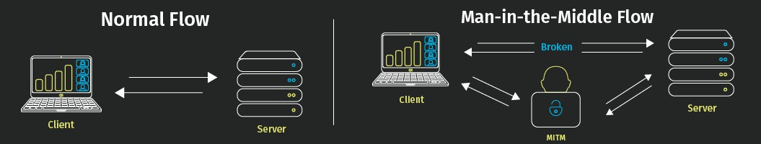
ATTACKS
95
▶ Man-in-the-Middle (MITM)
▶ the attacker secretly relays and possibly alters the communications between two parties who believe that they are directly communicating with each other
▶ Pass the Hash
▶ an attacker captures a password hash (as opposed to the password characters) and then simply passes it through for authentication and potentially lateral access to other networked systems.

Slide 48
ATTACKS
96
▶ Kerberos Exploitation
▶ Kerberos is a computer network security protocol that authenticates service requests between two or more trusted hosts across an untrusted network, like the internet
▶ Kerberos brute-force, Kerberoasting, Pass the key, Pass the ticket, Silver ticket, Golden ticket
▶ Ransomware
▶ Ransomware is a type of malicious software (malware) that threatens to publish or blocks access to data or a computer system, usually by encrypting it, until the victim pays a ransom fee to the attacker.
▶ Locker ransomware. This type of malware blocks basic computer functions
▶ Crypto ransomware. The aim of crypto ransomware is to encrypt your important data, such as documents, pictures and videos
▶ Locky, WannaCry, Bad Rabit, Petya, GoldenEye

Slide 49
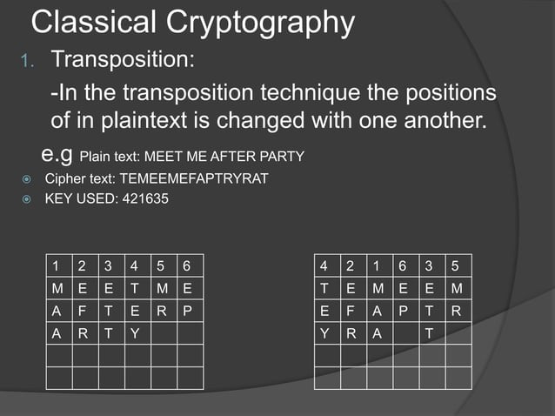

Slide 50
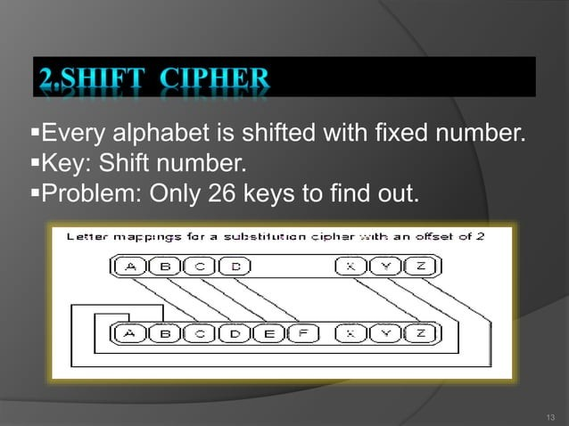

Slide 51
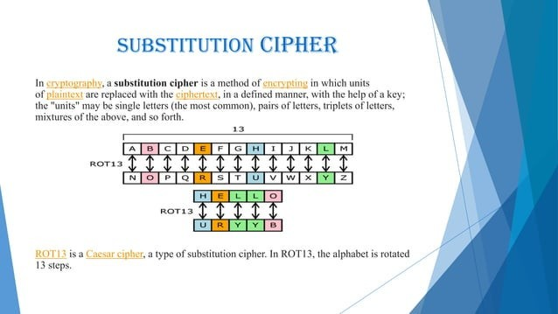

Slide 52
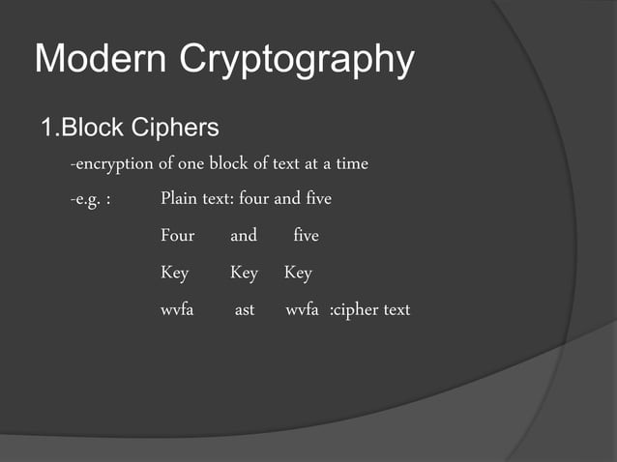

Slide 53
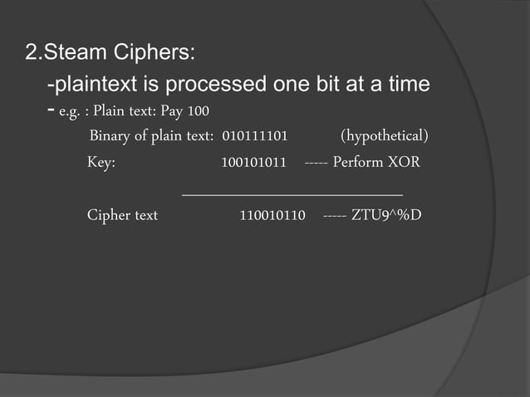

Slide 54
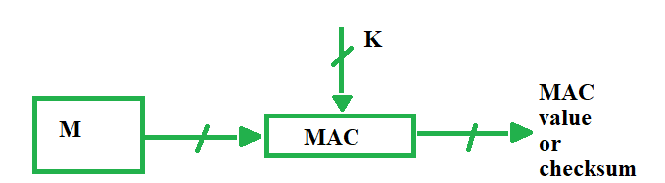
MESSAGE AUTHENTICATION CODE
Message authentication codes Apart from intruders, the transfer of message between two people also faces other external problems like noise, which may alter the original message constructed by the sender. To ensure that the message is not altered there’s this cool method MAC.

Slide 55
MAC stands for Message Authentication Code. Here in MAC, sender and receiver share same key where sender generates a fixed size output called Cryptographic checksum or Message Authentication code and appends it to the original message. On receiver’s side, receiver also generates the code and compares it with what he/she received thus ensuring the originality of the message. These are components:Message
Key
MAC algorithm
MAC value

Slide 56
WHAT IS HMAC(HASH BASED MESSAGE AUTHENTICATION CODE)?
HMAC (Hash-based Message Authentication Code) is a type of a message authentication code (MAC) that is acquired by executing a cryptographic hash function on the data (that is) to be authenticated and a secret shared key. Like any of the MAC, it is used for both data integrity and authentication. Checking data integrity is necessary for the parties involved in communication. HTTPS, SFTP, FTPS, and other transfer protocols use HMAC. The cryptographic hash function may be MD-5, SHA-1, or SHA-256. Digital signatures are nearly similar to HMACs i.e they both employ a hash function and a shared key. The difference lies in the keys i.e HMACs use symmetric key(same copy) while Signatures use asymmetric (two different keys).

Slide 57
Advantages
HMACs are ideal for high-performance systems like routers due to the use of hash functions which are calculated and verified quickly unlike the public key systems.
Digital signatures are larger than HMACs, yet the HMACs provide comparably higher security.
HMACs are used in administrations where public key systems are prohibited.
Disadvantages
HMACs uses shared key which may lead to non-repudiation. If either sender or receiver’s key is compromised then it will be easy for attackers to create unauthorized messages.

Slide 58
Working of HMAC
HMACs provides client and server with a shared private key that is known only to them. The client makes a unique hash (HMAC) for every request. When the client requests the server, it hashes the requested data with a private key and sends it as a part of the request. Both the message and key are hashed in separate steps making it secure. When the server receives the request, it makes its own HMAC. Both the HMACS are compared and if both are equal, the client is considered legitimate.
The formula for HMAC:
HMAC = hashFunc(secret key + message)

Slide 59
The major difference between MAC and hash (HMAC here) is the dependence of a key. In HMAC we have to apply the hash function along with a key on the plain text. The hash function will be applied to the plain text message. But before applying, we have to compute S bits and then append it to plain text and after that apply the hash function. For generating those S bits we make use of a key that is shared between the sender and receiver.

Slide 60
Digital Signatures
Once a cryptographic hash is created for a message, the hash is encrypted with the sender's private key. This encrypted hash is called a digital signature.
Message Authentication Code
A message authentication code (MAC) is similar to a cryptographic hash, except that it is based on a secret key. When secret key information is included with the data that is processed by a cryptographic hash function, the resulting hash is known as an HMAC.
If Alice wants to be sure that Charlie does not tamper with her message to Bob, she can calculate an HMAC for her message and append the HMAC to her original message. She can then encrypt the message plus the HMAC using a secret key that she shares with Bob. When Bob decrypts the message and calculates the HMAC, he will be able to tell if the message was modified in transit. With TLS, an HMAC is used with the transmission of secure data.

Slide 61
CRYPTOGRAPHIC HASH FUNCTIONS
When sending encrypted data, TLS typically uses a cryptographic hash function to ensure data integrity. The hash function prevents Charlie from tampering with data that Alice sends to Bob.
A cryptographic hash function is similar to a checksum. The main difference is that whereas a checksum is designed to detect accidental alterations in data, a cryptographic hash function is designed to detect deliberate alterations.
When data is processed by a cryptographic hash function, a small string of bits, known as a hash, is generated. The slightest change to the message typically makes a large change in the resulting hash. A cryptographic hash function does not require a cryptographic key. A hash function often used with TLS is Secure Hash Algorithm (SHA). SHA was proposed by the U.S. National Institute of Standards and Technology (NIST).

Slide 62
WHAT PROBLEMS ARE WE TRYING TO SOLVE?
Authentication
  The process of reliably verifying the identity of someone or something
    In particular, did a message indeed come from its specified sender?
Need to guard against:
  Disclosure of a message to any unauthorized person or system
  Messages masquerading as being from a source
  Content modification
    Was the message changed between sender and recipient?)
  Source or destination repudiation
    Can the sender or recipient deny they sent/received the message?

Slide 63
AUTHENTICATION FUNCTIONS
Three main classes:
  Message Encryption
    Ciphertext of entire message serves as its authenticator
  Message Authentication Code (MAC)
    Function of the message and a secret key which produces a fixed-length authenticator value
  Hash Function
    Function which maps a message of any length into a fixed-size hash authenticator value

Slide 64


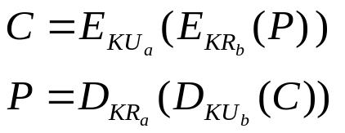
MESSAGE ENCRYPTION
We've already seen various encryption options:
  Symmetric Encryption – provides both confidentiality and authentication
  Public Key Encryption:
    provides confidentiality only
    provides authentication & signature
    provides confidentiality, authentication, and signature

Slide 65
MESSAGE AUTHENTICATION CODE (MAC)
Uses a secret key to generate a small fixed-size block of data: a Cryptographic Checksum, or MAC
If Alice and Bob share a common secret key, K, then:
    MAC = F_{K}(P)
where:
    P is the input plaintext
    F is the MAC function
    K is the shared secret key
    MAC is the resulting message authentication code

Slide 66
MESSAGE AUTHENTICATION CODE (MAC)
The MAC is sent to the recipient along with its associated message
  The recipient uses the same MAC function and key on the message and compares the result with the transmitted MAC.
  If the two MACs match, the recipient is assured that:
    The message has not been altered, and
    The message is from the alleged sender
  If the message contains a sequence number (e.g. TCP header), then the recipient is assured of the proper sequencing of messages

Slide 67
MESSAGE AUTHENTICATION CODE (MAC)
A MAC function is similar to an encryption function, except that the MAC function need not be reversible.
A MAC function is typically a many-to-one function:
  The input messages can be of any length, but
  The output is of fixed length (n bits)
If an n-bit MAC function (that is, a MAC function that generates a fixed-size n-bit block) is used, how many possible MAC values are there?
2^{n}

Slide 68
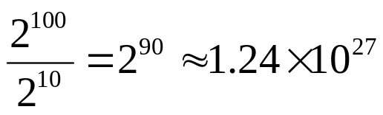
MESSAGE AUTHENTICATION CODE (MAC)
For example, assume:
  We are using a 10-bit MAC function
  We are using 100-bit messages
There are:
  2¹⁰⁰ (~ 1.27 * 10³⁰) different possible messages:
  only 2¹⁰ (1024) different possible MACs
so, on average, each MAC value is generated by a total of
different messages

Slide 69
ONE-WAY HASH FUNCTIONS
Can be viewed as a variation on a MAC function:
  A Hash Function accepts a variable-size message, M, as input and produces a fixed-size output, referred to as a Hash Code, or Message Digest:
        h = H(M)
  Unlike a MAC function, a hash code:
    does not use a key, and so
    is a function only of the input message
  A change to any bit (or bits) of the message results in a change to the hash code, which can provide an error-detection capability.
  A message digest can be used as a fingerprint for a message, to allow detection of message modification

Slide 70
ONE-WAY HASH FUNCTIONS
The NSA designed the Secure Hash Algorithm (SHA)
The National Institute of Standards and Technology (NIST), made it a standard.
  They revised it very late in the game, because of some (unspecified) weakness that had been found, and changed its name to SHA-1¹.
  SHA-1 is a 160-bit hash function based on MD4
  Shares much in common with MD5, but has a much more conservative design.
  2 or 3 times slower than MD5
1http://www.itl.nist.gov/fipspubs/fip180-1.htm

Slide 71
ONE-WAY HASH FUNCTIONS
Because of improving computing environments, the 160-bit hash of SHA-1 is now becoming a liability
So NIST produced SHA-256, SHA-384, and SHA-512¹.
  Designed to be used with the 128-, 192- and 256-bit key sizes of AES.
  Structure similar to SHA-1, but much slower.
  According to Ferguson & Schneier, they are too new to have experienced significant cryptanalysis attacks, and so are not yet proven. But they also say that MD5 and SHA-1 are not sufficiently secure, so you may have little choice.
1http://csrc.nist.gov/publications/fips/fips180-2/fips180-2.pdf

Slide 72
HMAC
HMAC¹ is an attempt to use a hash function to build a MAC.
Note that:
  Hash functions provide only n/2 bits of security against some attacks
  A MAC function is expected to provide n bits of security.
  Defining:
    MAC(K, m) = h(K || m), or h(m || K), or h(K || m || K)
  is not secure if you use one of the standard hash functions.
HMAC was proven to be secure if the underlying hash function's underlying compression function was secure.
1http://www.faqs.org/rfcs/rfc2104.html
There is also a draft FIPS at:
http://csrc.nist.gov/CryptoToolkit/hmac/fr-hmac-200101.html

Slide 73
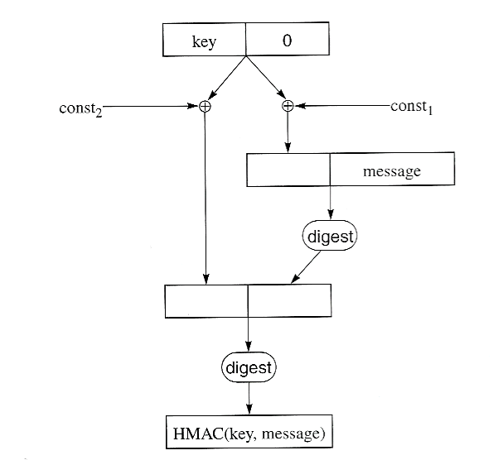
HMAC
HMAC takes a variable length key and a variable length message, and produces a fixed-size output that is the same size as the underlying hash function.
  It first pads the key with 0 bits to 512 bits
  If the key is larger than 512 bits, it first hashes the key, resulting in 128 or 160 bits, and then pads the result out to 512 bits.
  It then XORs the padded key with a constant string of octets of value 36 (hex), then concatenates the result with the message, and computes a hash (digest)
  It XORs the padded key with a different constant string of octets of value 5C (hex), concatenates that with the result of the of the first hash, and computes a second hash on that.

Slide 74
HMAC
Examples of HMAC algorithms are:
  HmacMD5 – uses the MD5 hash algorithm
  HmacSHA1 – uses the SHA-1 hash algorithm

Slide 75

Threats to E-mail
^{O} Loss of confdentiality.
-mails are sent in clear over open networks.
E-waifs stored on potentially
insecure clients and mail servers.
O Loss of integrity.
No integrity protection on e-malls; anybody be altered in transit or on mail server.

Slide 76
Threats to E-mail
^{O} Lack of data origin authentication.
Is this e-mail really from the person
named in the From: feT
^{O} Lack of non-repudiation.
Can I rely and act on the content? (integrity)
If so, can the sender later deny having
sent iU Who is liable iL I have accede

Slide 77
Threats to E-mail
O Lack of notification of receipt.
Has the intende‹J recipient received
my e-mail and acted on it?
A message locally marked as ‘sent’ may not have been delivered.

Slide 78
E-mail security
^{O} What are the Options*
Secure the server to client
connections (easy thing first)
https access to webmail
Protection against insecure wireless access
Secure the end-to-end email delivery
The PGPs of the world
Practical in an enterprise intra-network environment

Slide 79
E-mail security
^{O} Email based Attacks
Active content attack
Clean up at the server
Buffer over-flow attack
Fix the code
Trojan Horse Attack
Web bugs (for tracking)
Mangle the image at the mail server

Slide 80


E-mail security
^{O} Software for encrypting email messages has been widely available for more than 15 years, but the email-using public has failed to adopt secure messaging. This failure can be explained through a combination of:
technical,
community,
and usability factors

Slide 81
E-mail security
^{O} Why Don't People Use Email Security?
I don't because I don't care.
I doubt any of my usual recipients would
understand
the significance of the signature.
Never had the need to send these kinds of emails.
I don't think it's necessary to encrypt my
email.
it's just another step & something else I don t have time

Slide 82
E-mail security
0
Secure E-mail Standards and
Products
Other now defunct standards: PEM
(privacy enhancecl mail), X.400.
SfMlME.
We focus on PGP

Slide 83
S/MIME
(Secure/Multipurpose Internet Mail Extension)
^{O} Originated from RSA Data Security Inc. in 1995.
^{O} Further development by IETF SfMIME working group at: www.ietf.org/html.charters/smime-charter.html.
Version 3 specified in RFCs2630-2634.
O Allows flexible client-client security through
encryption and signatures.
^{O} Widely supported, e.g. in Microsoft Outlook, Netscape Messenger, Lotus Notes.

Slide 84

PGP
(PRETTY GOOD PRIVACY)
Freeware: Open PGP and variants:
www.openpgp.org, www.gnupg org
Open PGP specified in RFC 2440 and defined by IETF Open PGP worhing group.
www.ietf.org/html.charters/openpgp- charter.html
O
^{O} Available as plug-in for popular e-mail clients,
can also be used as stand-alone software.

Slide 85
PGP
(PRETTY GOOD PRIVACY)
^{O} PGP is an e-mail security program written by Phil Zimmermans, based on the IDEA algorithm for encryption of plaintext and uses the RSA Public Key algorithm for encryption of the private key.
^{O} PGP incorporates tools for developing a public- key trust model and public-key certificate management.

Slide 86

PGP
(PRETTY GOOD PRIVACY)
PGP is an open-source freely available software package for e-mail security. It provides authentication; confidentiality; compression; e-mail compatibility; and segmentation and reassembly.

Slide 87
SERVICES
•
Digital signature
DSS/SHA or RSA/SHA
A hash code of a message is created using SHA-1 This message digest is encrypted using DSS or RSA with the sender's private key and included with the message
A message is encrypted using
CAST-128 or IDEA or 3DES
with a one-time session key generated by the sender. The session key is encrypted using Diffie Hellman or RSA with the recipient's public key and included with the message.
Message
encryption
CAST or IDEA or Three-key Triple DES with Diffie- Hellman or RSA

Slide 88
PGP
(PRETTY GOOD PRIVACY)
Compression ZIP
A message may be compressed, for storage or transmission, using ZIP.
To provide transparency for email applications, an encrypted message may be converted to an ASCII string using radix 64 conversion.
To accommodate maximum message size limitations, PGP performs segmentation and reassembly.
Email
compatibility
Radix 64
conversion
Segmentation

Slide 89
